Slide 1
Bible Study Methods
Part 016 - Observing God’s Word - WHAT DOES IT SAY?

Slide 2
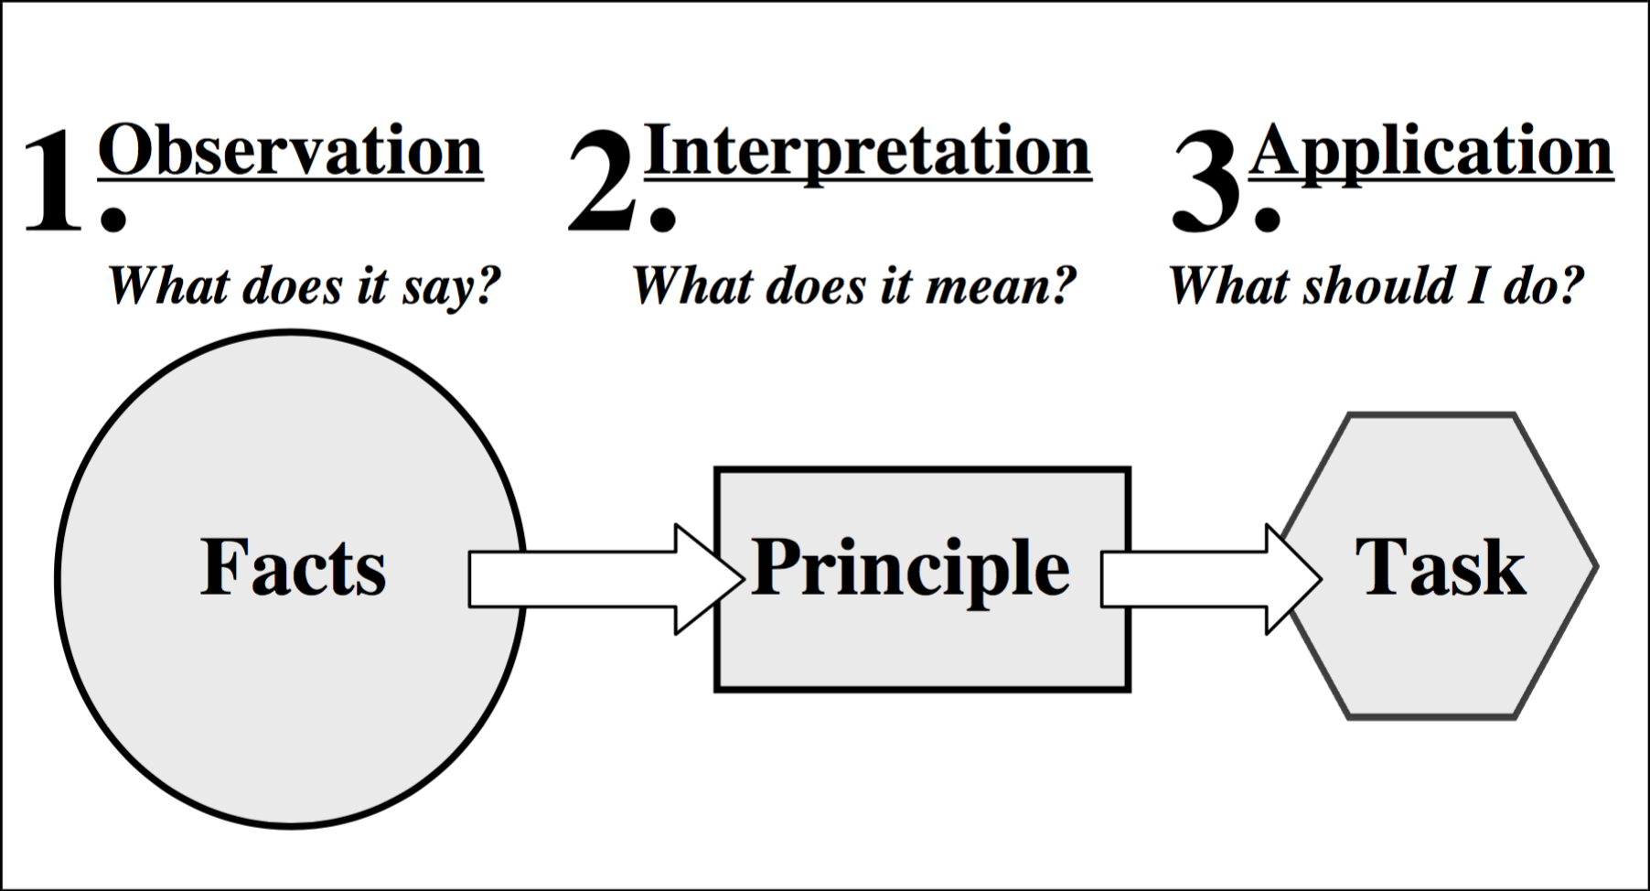

Slide 3
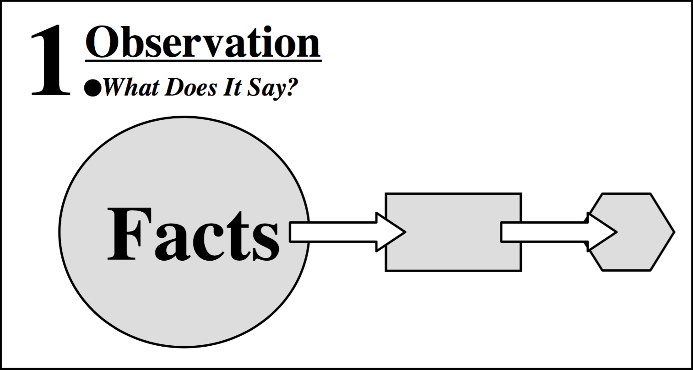
OBSERVATION—WHAT DOES THE TEXT SAY?

Slide 4
Prepare for Observation
Belief

Slide 5
Prepare for Observation
Belief
Prayer

Slide 6
Prepare for Observation
Belief
Prayer
Readiness to Obey

Slide 7
Prepare for Observation
Belief
Prayer
Readiness to Obey
Self-examination

Slide 8
Prepare for Observation
Belief
Prayer
Readiness to Obey
Self-examination
Willingness to Learn

Slide 9
Prepare for Observation
Take Enough Time

Slide 10
Prepare for Observation
Take Enough Time
Look at the Context
What do the preceding and following verses talk about?
What is the theme of the paragraph?
What is the theme of the chapter?
What is the purpose and theme of the book?
Is the passage in the Old or New Testament and what does this mean?

Slide 11
Prepare for Observation
Take Enough Time
Look at the Context
Examine the Structure
Key words
Comparisons or contrasts
Progression of an idea
Verbs
Conjunctions
Illustrations
Kind of literature

Slide 12
KINDS OF FIGURATIVE LANGUAGE IN THE BIBLE
Simile

Slide 13
KINDS OF FIGURATIVE LANGUAGE IN THE BIBLE
Simile
Parable

Slide 14
KINDS OF FIGURATIVE LANGUAGE IN THE BIBLE
Simile
Parable
Metaphor

Slide 15
KINDS OF FIGURATIVE LANGUAGE IN THE BIBLE
Simile
Parable
Metaphor
Allegory

Slide 16
KINDS OF FIGURATIVE LANGUAGE IN THE BIBLE
Simile
Parable
Metaphor
Allegory
Hyperbole

Slide 17
KINDS OF FIGURATIVE LANGUAGE IN THE BIBLE
Simile
Parable
Metaphor
Allegory
Hyperbole
Sarcasm

Slide 18
How can we know?
Does the passage state that it is figurative? (“Listen to another parable…” “The Kingdom of Heaven is like” Mt 21:33).
Does the passage become absurd or impossible if it is interpreted literally? (“I see a boiling pot, tilting away from the north... from the north disaster will be poured out on all who live in the land...” Jer 1:13-14).
Does the passage describe God, who is Spirit, as if He had a physical body and other strictly human qualities? (“Then the Lord reached out His hand and touched my mouth..." Jer 1:9).

Slide 19
KINDS OF LITERATURE IN THE BIBLE
History

Slide 20
KINDS OF LITERATURE IN THE BIBLE
History
Instruction

Slide 21
KINDS OF LITERATURE IN THE BIBLE
History
Instruction
Prophecy

Slide 22
KINDS OF LITERATURE IN THE BIBLE
History
Instruction
Prophecy
Poetry

Slide 23
KINDS OF LITERATURE IN THE BIBLE
History
Instruction
Prophecy
Poetry
Apocalypse

Slide 24
Key observation questions

