Slide 1
Bible Study Methods
Part 015 - Introduction to the Inductive Bible Study Method - LETTING THE BIBLE TEACH US

Slide 2
Do your best to present yourself to God as one approved, a worker who has no need to be ashamed, rightly handling the word of truth.
2Ti 2:15

Slide 3
HOW WE RECEIVED THE BIBLE
Inspiration

Slide 4
HOW WE RECEIVED THE BIBLE
Inspiration
Preservation

Slide 5
HOW WE RECEIVED THE BIBLE
Inspiration
Preservation
Canonisation

Slide 6
HOW WE RECEIVED THE BIBLE
Inspiration
Preservation
Canonisation
Translation

Slide 7
HOW WE RECEIVED THE BIBLE
Inspiration
Preservation
Canonisation
Translation
Illumination

Slide 8
INDUCTIVE VS. DEDUCTIVE

Slide 9
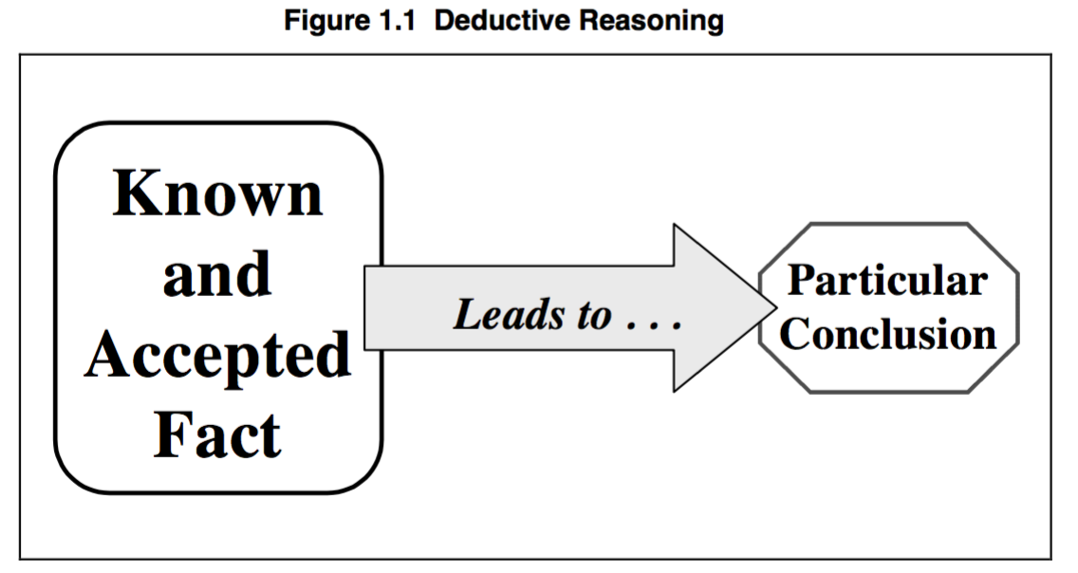
DEDUCTIVE

Slide 10
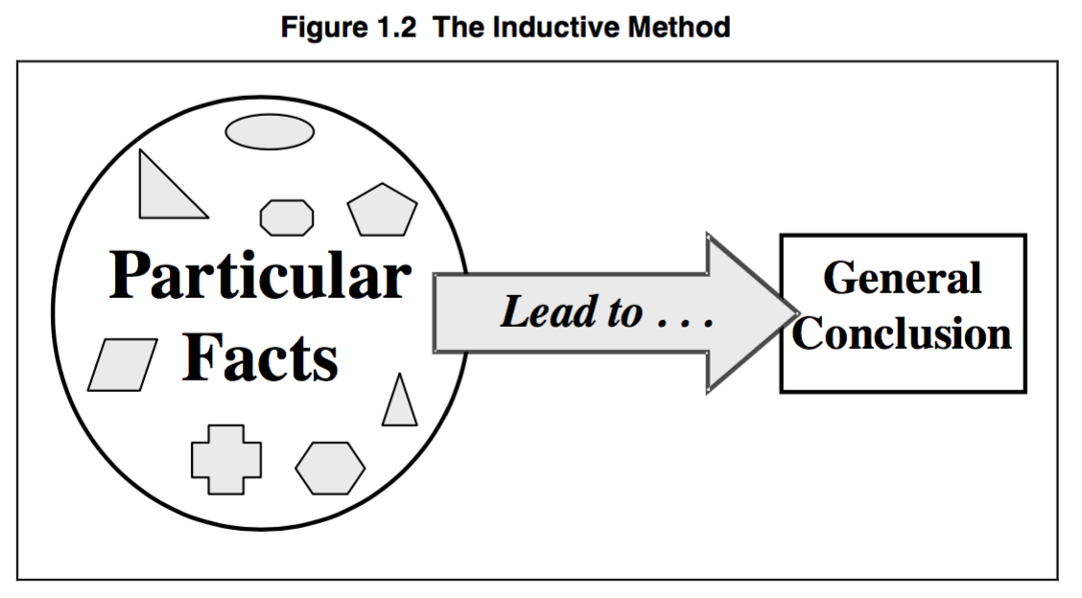
INDUCTIVE

Slide 11
STEPS OF INDUCTIVE BIBLE STUDY
What does it say? [Observation]
What does it mean? [Interpretation]
What should I do? [Application]

Slide 12
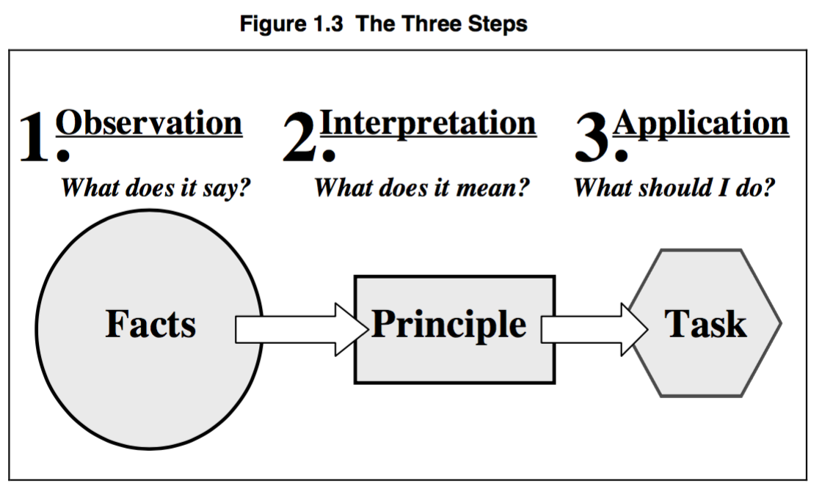

Slide 13
BUILDING A SOLID PYRAMID

Slide 14
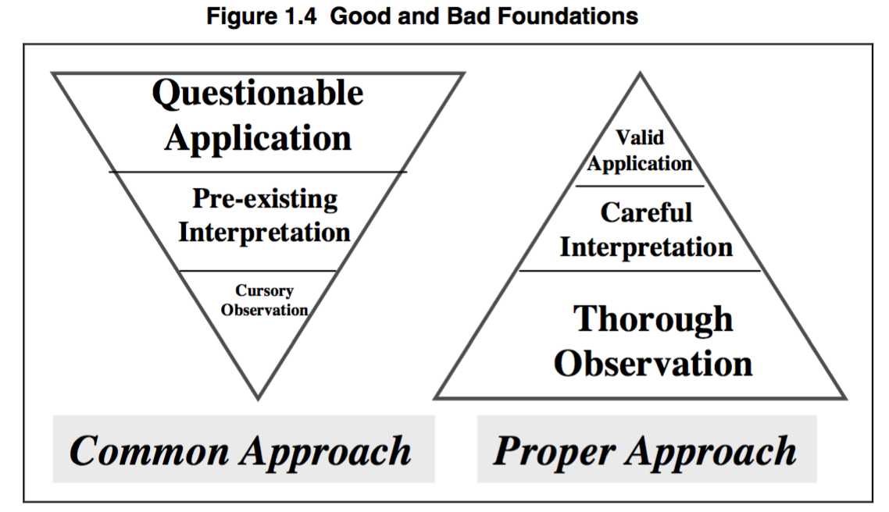
BUILDING A SOLID PYRAMID

Slide 15
QUESTIONS
What is the basic difference between deduction and induction?
Why is the inductive method a superior method of studying the Bible, compared to the deductive method?
What are the dangers of the “common” approach to Bible study and preaching?

