Slide 1
Spiritual Character
Part 011 - Christian Growth
Making Christ the focal point of our lives

Slide 2
WHAT IS SPIRITUAL GROWTH?

Slide 3
WHAT IS SPIRITUAL GROWTH?
Philippians 2:12- 13,
“Work out your salvation with fear and trembling, for it is God who works in you, to will and to act according to His good purpose.”

Slide 4
WHAT IS SPIRITUAL GROWTH?
The Ladder or Stairs
Many believers view spiritual growth as a ladder or as a set of stairs that we climb. When we are really spiritual, we consider ourselves to be high on the ladder. However, when we are not spiritual, we are low on the ladder.

Slide 5
WHAT IS SPIRITUAL GROWTH?
The Dying of the old self
Others view spiritual growth as a process of exchanging the old sinful self for the new man created in Christ. As the old man dies, the new man comes into being. When that happens, the person grows spiritually.

Slide 6
QUESTION:
Discuss how these 2 illustrations can be helpful and unhelpful

Slide 7
THE ROLE OF THE CROSS IN SPIRITUAL GROWTH
Growing in Knowledge of God’s Holiness
Jer 9:23,24
“Let not the wise man boast of his wisdom or the strong man boast of his strength or the rich man boast of his riches, but let him who boasts boast about this: that he understands and knows me, that I am the Lord who exercises kindness, justice and righteousness on earth; for in these I delight, declares the Lord”.
In John 17:3 Jesus says,
”Now this is eternal life: that they may know You, the only true God, and Jesus Christ whom You sent.”

Slide 8
THE ROLE OF THE CROSS IN SPIRITUAL GROWTH
The Westminster Catechism puts it like this:
Man's chief end is to glorify God, and to enjoy him for ever.

Slide 9
QUESTION:
Discuss times where you have experienced this growing sense of the Holiness of God

Slide 10
THE ROLE OF THE CROSS IN SPIRITUAL GROWTH
Php 3:8
”I consider everything a loss compared to the surpassing greatness of knowing Christ Jesus my Lord”.

Slide 11
QUESTION:
How can we increase our revelation of His Holiness?

Slide 12
THE ROLE OF THE CROSS IN SPIRITUAL GROWTH
Learning to Recognise Our Sin
Paul’s Progress:
In AD 55 Paul described himself as “the least of the apostles” (1Co 15:9).

Slide 13
THE ROLE OF THE CROSS IN SPIRITUAL GROWTH
Learning to Recognise Our Sin
Paul’s Progress:
In AD 55 Paul described himself as “the least of the apostles” (1Co 15:9).
Later in AD 60 Paul describes himself as “the least of all saints” (Eph 3:8).

Slide 14
THE ROLE OF THE CROSS IN SPIRITUAL GROWTH
Learning to Recognise Our Sin
Paul’s Progress:
In AD 55 Paul described himself as “the least of the apostles” (1Co 15:9).
Later in AD 60 Paul describes himself as “the least of all saints” (Eph 3:8).
Still later, in the end of his life in AD 64, he describes himself as “chief of all sinners” (1Ti 1:15).

Slide 15
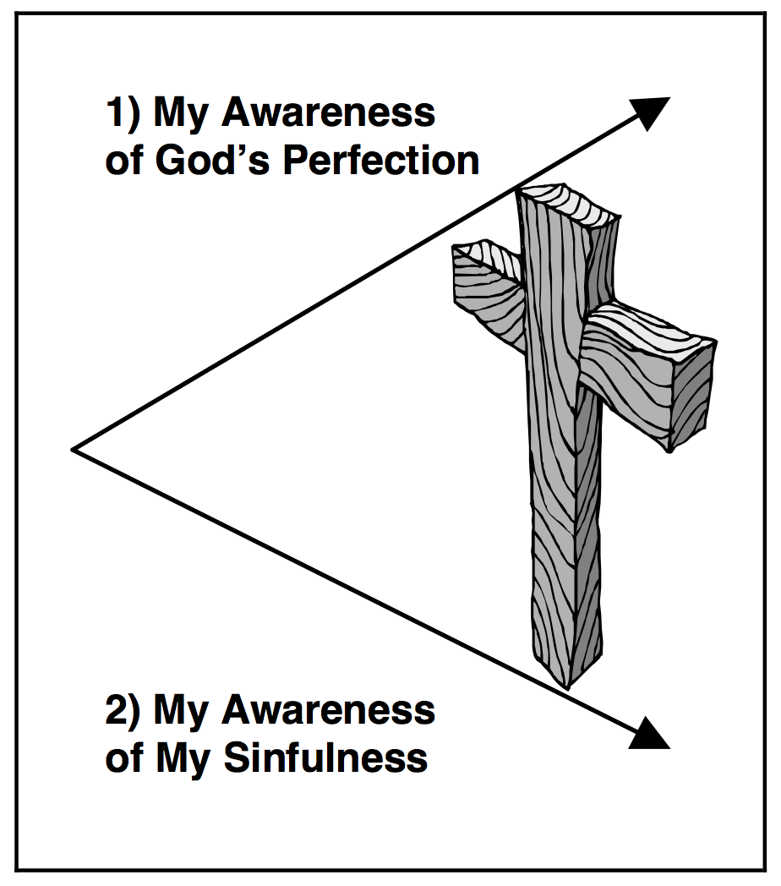
THE ROLE OF THE CROSS IN SPIRITUAL GROWTH
The Resulting Gap

Slide 16
HINDRANCES TO CHRISTIAN GROWTH

Slide 17
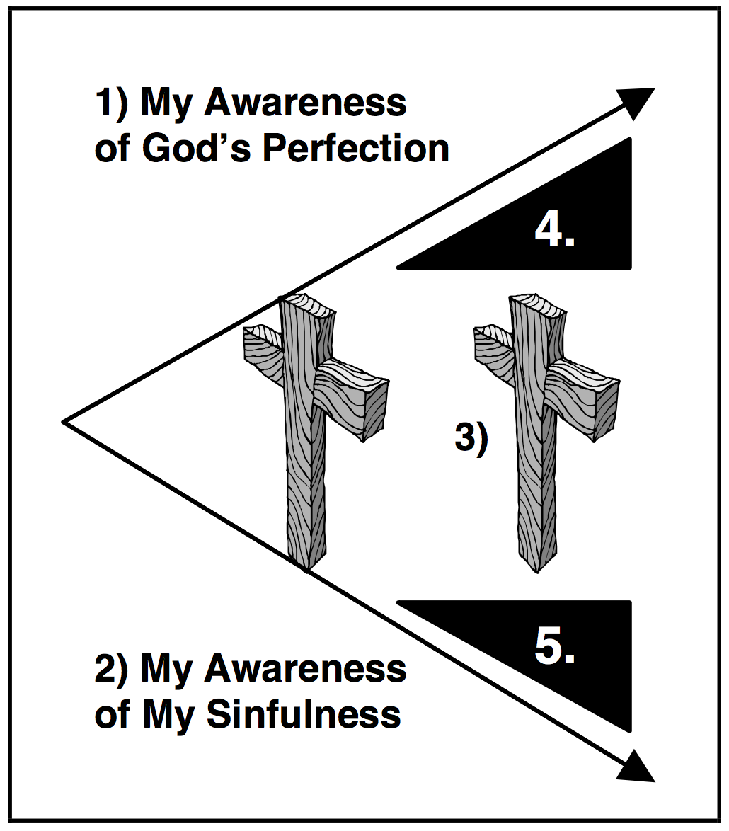
HINDRANCES TO CHRISTIAN GROWTH
Phariseeism—the problem of pride.

Slide 18
QUESTION:
What effect do those two wedges have on us?

Slide 19
HINDRANCES TO CHRISTIAN GROWTH
Matthew 7:3-5
Why do you see the speck that is in your brother's eye, but do not notice the log that is in your own eye? Or how can you say to your brother, ‘Let me take the speck out of your eye’, when there is the log in your own eye? You hypocrite, first take the log out of your own eye, and then you will see clearly to take the speck out of your brother's eye.

Slide 20
HINDRANCES TO CHRISTIAN GROWTH
Phariseeism—the problem of pride.
Despair—Lack of belief

Slide 21
QUESTION:
Are there any ways in which you identify with / recognise that feeling in yourself? Discuss how that makes you feel.

Slide 22
HINDRANCES TO CHRISTIAN GROWTH
Heb 10:14
For by a single offering he has perfected for all time those who are being sanctified.

Slide 23
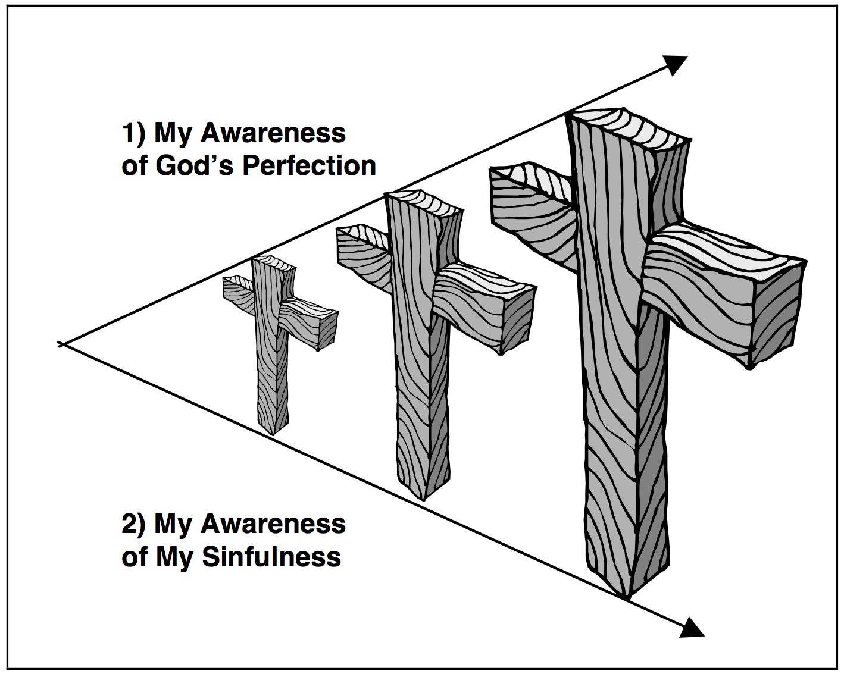
HINDRANCES TO CHRISTIAN GROWTH
Phariseeism—the problem of pride.
Despair—Lack of belief
The Answer: The Cross must grow

Slide 24
Spiritual Character
Part 011 - Christian Growth
Making Christ the focal point of our lives

