Slide 1
What’s the Church all about?
Part 007 - Form and Function - A biblical View

Slide 2
FORM AND FUNCTION ILLUSTRATED
Function = an activity that needs to be performed
Form = the method chosen to carry out the function

Slide 3
Getting Food
How do you decide which is the best form for you?
Some of the factors for the decision come from internal sources, such as abilities and preferences. Do you have a good eye and donʼt mind being alone for long periods of time? Then you might do better as a hunter. If not, stick with farming.
Some of the factors are external, depending on your environment. Do you live on or near good productive land? If so, you might do well to be a farmer.
Some of the factors are cultural, depending on the ideas of the society you are in. Are farmers prized because they add to the amount of crops in the village, or are hunters prized for their skill in case of war?
Some of the factors may be moral. Is the killing of animals looked upon as immoral?
Another factor is tradition. What did your parents and their parents do?

Slide 4
FORM AND FUNCTION IN THE CHURCH

Slide 5
FORM AND FUNCTION IN THE CHURCH
Church Functions

Slide 6
FORM AND FUNCTION IN THE CHURCH
Church Functions
QUESTION:
Can you come up with some examples of Church Functions?

Slide 7
FORM AND FUNCTION IN THE CHURCH
Church Forms

Slide 8
FORM AND FUNCTION IN THE CHURCH
Church Forms
QUESTION:
Can you come up with some examples of Church FORMS?

Slide 9
FORM AND FUNCTION IN THE CHURCH
Form and Function Together

Slide 11
Question:
Can you think of some functions that have different forms in different cultures / times in history?

Slide 12
EVALUATING FORM AND FUNCTION IN THE CHURCH
Table - Forms and Functions
Biblical Function | Possible Form
Prayer | Keeling or Standing
 | Silently or Aloud
 | Small Group or Individual
 | Before Meal or at close of Service
 | Confession or Supplication
Teaching the Word | Sermon
 | Small Groups
 | Bible Study
 | Family Devotions
Evangelise | Friendship Evangelism
 | Crusades
 | Altar Call in Service

Slide 13
Function Vs Form
Function | Form
Give
Worship

Slide 14
Forms Vs Functions
Function | Form
 | Youth Camp
 | Church Prayer Meeting
 | Church Choir
 | Passing an Offering Round
 | Church Buildings
 | Music in Services
 | Kid’s Church
 | Church order of service
 | Reading Poetry in Church

Slide 15
PRINCIPLES REGARDING FORM AND FUNCTION
The Function Is More Important Than the Form

Slide 16
PRINCIPLES REGARDING FORM AND FUNCTION
The Function Is More Important Than the Form
Functions Are Absolute and Trans-Cultural; Forms Are Non-Absolute and Variable

Slide 17
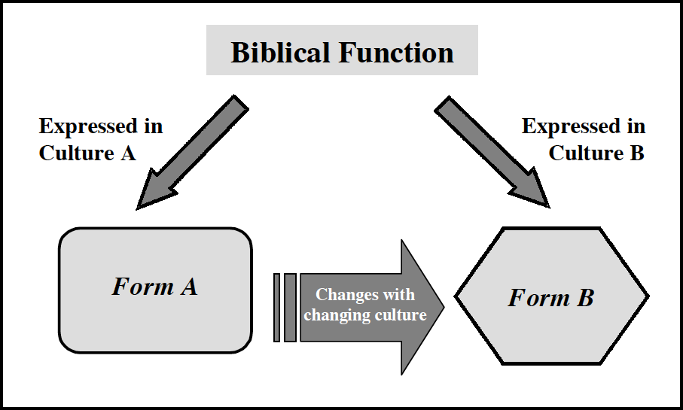

Slide 18
QUESTION:
How would this principle affect the way you develop forms in your church, based on Scripture?

Slide 19
PRINCIPLES REGARDING FORM AND FUNCTION
The Function Is More Important Than the Form
Functions Are Absolute and Trans-Cultural; Forms Are Non-Absolute and Variable
People Often Identify More with the Forms Than with the Function

Slide 20
Question:
Can you think of some forms people get attached to?

Slide 21
PRINCIPLES REGARDING FORM AND FUNCTION
The Function Is More Important Than the Form
Functions Are Absolute and Trans-Cultural; Forms Are Non-Absolute and Variable
People Often Identify More with the Forms Than with the Function
Forms Should Not Be Changed Carelessly

Slide 22
PRINCIPLES REGARDING FORM AND FUNCTION
The Function Is More Important Than the Form
Functions Are Absolute and Trans-Cultural; Forms Are Non-Absolute and Variable
People Often Identify More with the Forms Than with the Function
Forms Should Not Be Changed Carelessly
When Forms Freeze, Churches Die

Slide 23
IMPLICATIONS OF FORM AND FUNCTION
Biblical function is what must be done—it was given by God and should not be altered.
Biblical form is how we do the function—it is cultural and should be adjusted as needed

Slide 24
QUESTIONS
Do the forms in your church experience serve a purpose / biblical function?
Which forms are a hindrance to bringing the Gospel to the lost? To bringing a new convert into the life of the church?
In what ways are your forms strange and foreign to new converts?
How could you develop forms that would be more comfortable to new converts without compromising biblical principles? Describe how these forms are relevant to your target group culture in worship, fellowship, sacraments, tithing, and biblical instruction
When are forms sinful? Why? Give examples and validate with a biblical principle.

