Slide 1
What’s the church all about?
Part 005 - The purpose of the church

Slide 2
The purpose of the church
Luke 4:18-19
‘The Spirit of the Lord is on me, because He has anointed me to preach good news to the poor. He has sent me to proclaim freedom for the prisoners and recovery of sight for the blind, to release the oppressed, to proclaim the year of the Lord’s favour’

Slide 3
The purpose of the church
A clear understanding of biblical purpose can make a church:
purposeful and expectant.
faithful and flexible, innovative yet true to Scripture.
gracious and relational, emphasising God’s love and forgiveness.
joyful and celebrate (people are looking for this).
vital and dynamic, equipping people for real life ministry.
growing and reproducing, planting new churches

Slide 4
THE ROLE AND NATURE OF THE CHURCH TODAY
The Church—A Called-Out People With Both A Local And A Universal Manifestation
Eph 1:9-10
And He has made known to us the mystery of His will according to His good pleasure, which He purposed in Christ as a plan for the fullness of time, to bring all things in heaven and on earth together in Christ.

Slide 5
THE ROLE AND NATURE OF THE CHURCH TODAY
The Church—A Called-Out People With Both A Local And A Universal Manifestation
EKKLESIA
Acts 19:38-41
So if Demetrius and his fellow craftsmen have a complaint against anyone, the courts are open and proconsuls are available. Let them bring charges against one another there. But if you are seeking anything beyond this, it must be settled in a legal assembly. For we are in jeopardy of being charged with rioting for today’s events, and we have no justification to account for this commotion.”
After he had said this, he dismissed the assembly.

Slide 6
Question
Why has the word “church” got so many incorrect interpretations?
What did you think of “church” before you were saved and how did you change your opinion?

Slide 7
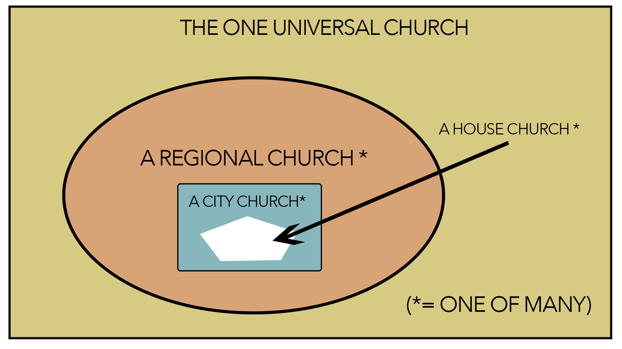

Slide 8
The Church Is The Body Of Christ

Slide 9
The Church Is The Body Of Christ
The Body Is Interdependent

Slide 10
The Church Is The Body Of Christ
The Body Is Interdependent
The Body Has One Head

Slide 11
The Church Is God’s Number One Instrument For Spreading The Gospel

Slide 12
THE PURPOSE OF THE CHURCH
Fig 1 - The Three Fold Purpose of the Church
Ultimate Purpose | Outward Purpose | Inward Purpose
Exalt the Lord | Evangelise the Lost | Edify the labourers
The Church Exists for the Lord | The Church Exists for the world | The church exists for itself

Slide 14
What’s the church all about?
Part 005 - The purpose of the church

