Slide 1
What’s the church all about?
Part 004 - The Foundation of the church.

Slide 2
GOD'S PLAN FOR THE AGES

Slide 3
“A brief history of the cosmos”
God’s Eternal Kingdom
Ps 10:16
The LORD is king forever and ever; the nations perish from his land.
Ps 103:19
The LORD has established his throne in the heavens, and his kingdom rules over all.

Slide 4
“A brief history of the cosmos”
God’s Eternal Kingdom
The Cosmic Rebellion
The Earthly Rebellion

Slide 5
Fellowship with God was broken.
The image of God in the man and woman was marred.
Man experienced physical and spiritual death.
The woman would experience suffering in childbirth.
The man would experience painful toil.
The ground (nature) was cursed (Ro 8:21-22).
Fellowship between the man and the woman was broken.
Rule over the earth was usurped by Satan who became ‘the god of this world.’

Slide 6
“A brief history of the cosmos”
God’s Eternal Kingdom
The Cosmic Rebellion
The Earthly Rebellion
God's Redemptive Plan

Slide 7
The redemption of Man, restoring him to the image of Christ (2Co 3:18).
The restoration of fellowship between God and Man and between men (1Jn 1:3-7).
The restoration of God’s reign over the earth (Rev 11:15) and man’s reign with him (Rev 22:5). The creation of a new earth (Rev 21:1).
Genesis 3:15
I will put enmity between you and the woman, and between your offspring and her offspring; he shall bruise your head, and you shall bruise his heel.”

Slide 8
The Background For The Church: Israel

Slide 9
The Background For The Church: Israel
The Nation of Israel

Slide 10
The Background For The Church: Israel
The Nation of Israel
The church

Slide 11
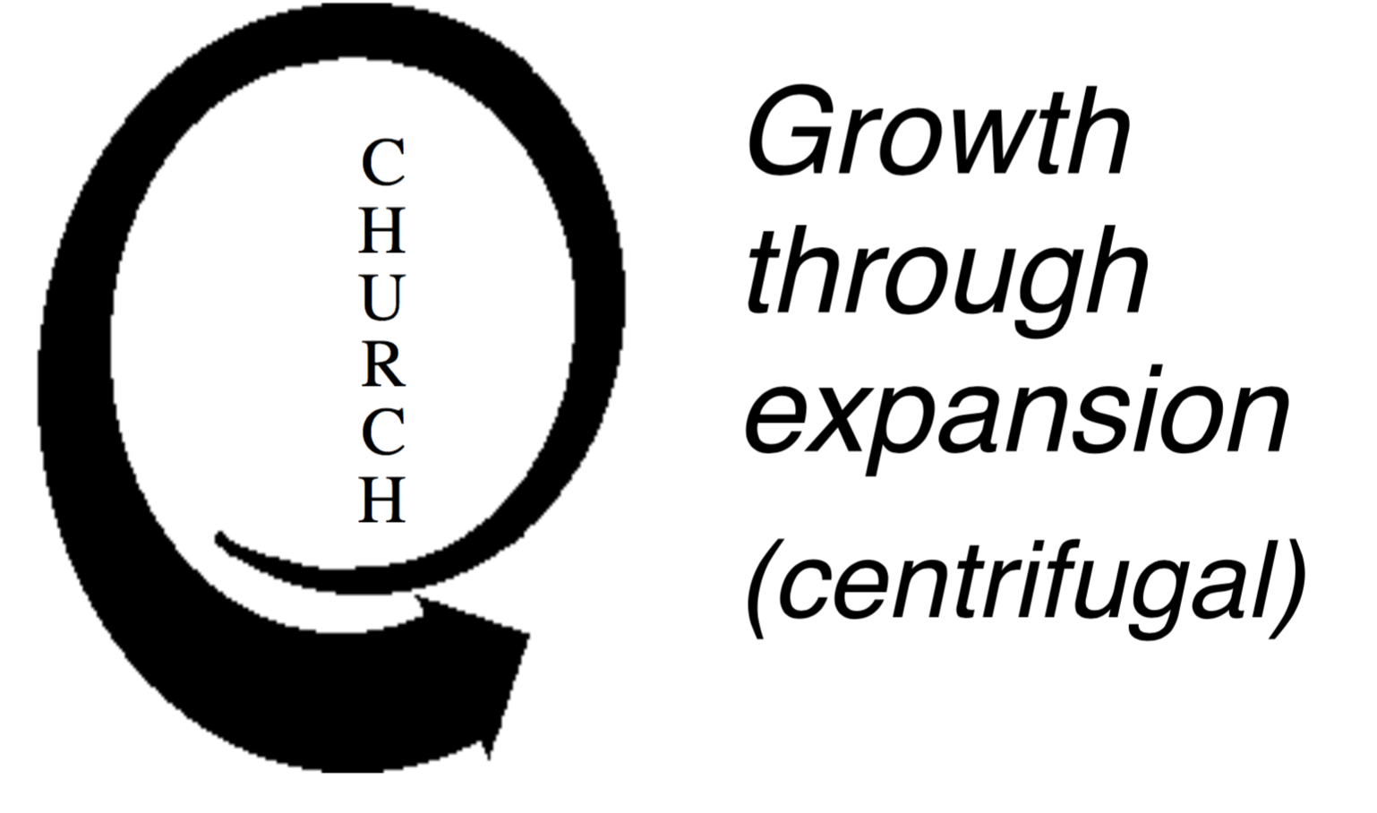
Comparison between The Nation Of Israel And The Church (Figure 1)
The Nation of Israel | The Church
The orientation of the ‘Nation’ was centripetal. God’s plan placed Israel as a light to the nations, to which the nations would COME to see and hear of His glory. To participate in His glory meant to come to the Nation. Growth by addition (birth, take by force, God-fearers) Centralised plan ‘when they come to this House’ God’s glory temporarily residing in Jerusalem (1Ch 28; 2Ch 6-7) | The orientation of the Church is centrifugal. God’s plan places the Church as a Light to the nations. The people of the Church are to GO and be salt and light among the nations (Mt 5:13-14; 28:18-20). Growth by multiplication (conversion, church planting) Decentralised plan ‘... into all the world’ Released and empowered by the eternally indwelling Holy Spirit (Ac 1-2); God’s glory residing in the hearts of men (2Co 3)

Slide 12
Question:
In what ways do you see the church sometimes making the mistake of falling back into Israel’s model?

Slide 13
The Prediction Of The Church: Matthew 16:18-19
Matthew 16:18-19
And I tell you, you are Peter, and on this rock I will build my church, and the gates of hell shall not prevail against it. I will give you the keys of the kingdom of heaven, and whatever you bind on earth shall be bound in heaven, and whatever you loose on earth shall be loosed in heaven.”

Slide 14
The Prediction Of The Church: Matthew 16:18-19
The church is built on the rock: “Upon this rock”

Slide 15
Question:
Why has this verse caused so much misunderstanding?

Slide 16
The Prediction Of The Church: Matthew 16:18-19
The church is built on the rock: “Upon this rock”
The Church belongs to Christ: “I will build My Church.”

Slide 17
The Prediction Of The Church: Matthew 16:18-19
The church is built on the rock: “Upon this rock”
The Church belongs to Christ: “I will build My Church.”
Jesus builds His Church through us: “I will build my Church.”

Slide 18
The Prediction Of The Church: Matthew 16:18-19
The church is built on the rock: “Upon this rock”
The Church belongs to Christ: “I will build My Church.”
Jesus builds His Church through us: “I will build my Church.”
The Church will be triumphant: “the gates of hell will not prevail against it”

Slide 19
QUESTIONS
What are the implications of the Church as centrifugal?
How does an Old Testament (centripetal) understanding of the Church affect its vitality? When is such an understanding of the local church appropriate? Why?
The Church exists for the world (Eph 3:1-10). What are the implications?

Slide 20
What’s the church all about?
Part 004 - The Foundation of the church.

