Slide 1
EVANGELISM
Part 3 - THIS IS WHAT GOD DID FOR ME!

Slide 2
THE NATURE OF A TESTIMONY
We are Called to be Witness

Slide 3
THE NATURE OF A TESTIMONY
We are Called to be Witness
We are Called to Give Testimony

Slide 4
THE VALUE OF A TESTIMONY
Overcoming resistance to the Gospel

Slide 5
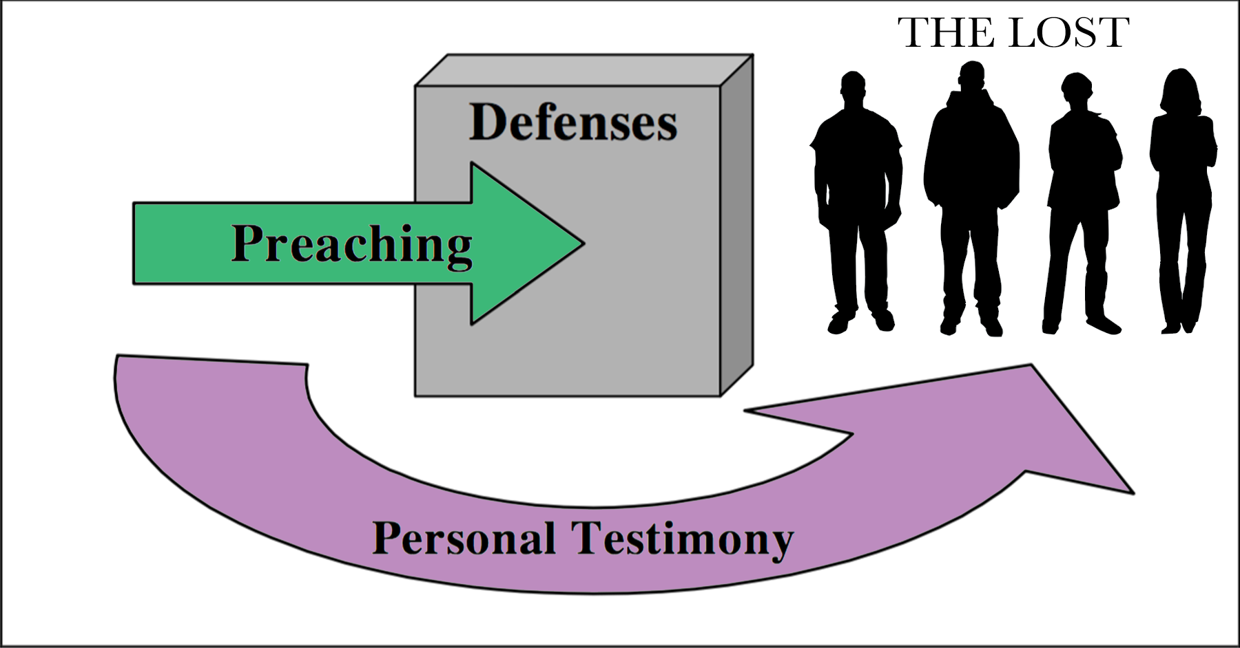
THE VALUE OF A TESTIMONY
Overcoming resistance to the Gospel

Slide 6
THE VALUE OF A TESTIMONY
Overcoming resistance to the Gospel
Overcoming Satan in spiritual warfare
Revelation 12:10-12
“... Now have come the salvation and the power and the kingdom of our God, and the authority of His Christ. For the accuser of our brothers, who accuses them before our God day and night, has been hurled down. They overcame him by the blood of the Lamb and by the word of their testimony; they did not love their lives so much as to shrink from death. Therefore rejoice, you heavens and you who dwell in them!”

Slide 7
EXAMPLES OF TESTIMONIES
The woman at the well (Jn 4:28-29)

Slide 8
EXAMPLES OF TESTIMONIES
The woman at the well (Jn 4:28-29)
The man born blind (Jn 9:13-34)

Slide 9
EXAMPLES OF TESTIMONIES
The woman at the well (Jn 4:28-29)
The man born blind (Jn 9:13-34)
Paul’s conversion (Ac 9, 22, and 26)

Slide 10
EXAMPLES OF TESTIMONIES
The woman at the well (Jn 4:28-29)
The man born blind (Jn 9:13-34)
Paul’s conversion (Ac 9, 22, and 26)
Paul’s testimony about events in Jerusalem (Ac 24:10-21)

Slide 11
THE PREPARATION OF A TESTIMONY

Slide 12
THE SHARING OF A PERSONAL TESTIMONY
Complete
Clear
Gospel
The Bad News
We are sinners, and the penalty is death
God is holy, and we cannot please Him
Jesus—the Son of God—died in our place
The Good News
We are saved by faith—not by our works
We are born again into God’s family as His children
We have the assurance of eternal life
Concise

Slide 13
QUESTIONS
Where are some places and what are some of the times in your day or week during which you could share your testimony?
What topics of general conversation might readily provide “openers” for the casual introduction of your testimony? Do you travel on public transportation?
Do you take breaks or eat a meal at work? Ask the Lord to arrange “divine appointments” for you to be able to share your testimony.

